Slide 1
Web engineering Instructed By Engr. M. Asif Shaikh
Lecture 2
Web Application Architecture

Slide 2
Head Lines
Web Application Architecture Components
3-Tier Architecture
Hypertext Markup Language (HTML5)
Cascade Style Sheet (CSS3)

Slide 3

Learning Objectives
At the end of this session, students will be able to
Define Web Application Architecture
Web 3 Tier Architecture
Implement HTML5
Implement CSS3
This will cover CLO-1

Slide 4
Brainstorming
What are the main components of Web Applicationb Engineering
Any Idea ?

Slide 5
Web Application Architecture Components
Typically a web-based application architecture comprises 3 core components:
1) Web Browser: The browser or the client-side component or the front-end component is the key component that interacts with the user, receives the input and manages the presentation logic while controlling user interactions with the application. User inputs are validated as well, if required.

Slide 6
2) Web Server: The web server also known as the backend component or the server-side component handles the business logic and processes the user requests by routing the requests to the right component and managing the entire application operations. It can run and oversee requests from a wide variety of clients.

Slide 7
3) Database Server: The database server provides the required data for the application. It handles data-related tasks. In a multi-tiered architecture, database servers can manage business logic with the help of stored procedures.

Slide 8
What is a 3-Tier Architecture?
Building a layered modern web app architecture helps you to identify the role of each component of an application and easily make changes to the corresponding layer without affecting the overall application.
It enables you to easily write, debug, manage and re-use code.
The three layers of a web app architecture:
Presentation layer / Client Layer
Application Layer / Business Logic Layer
Data Layer

Slide 9
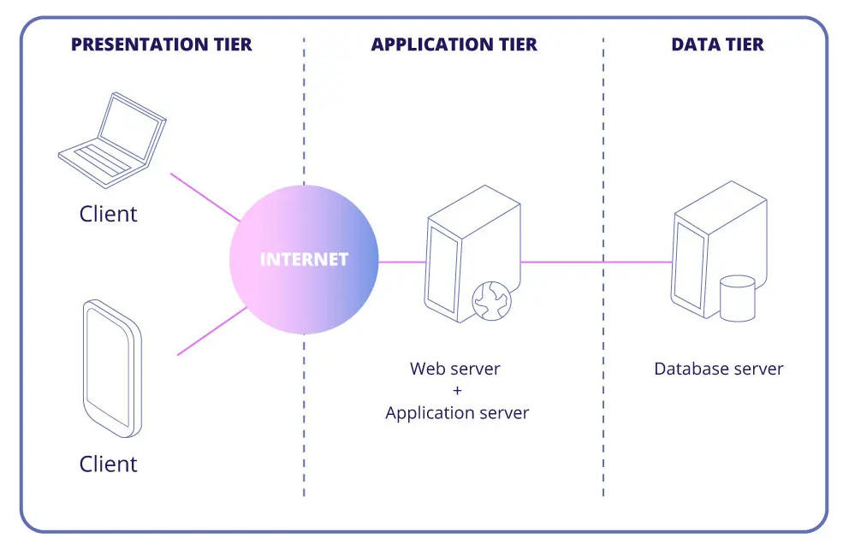

Slide 10
HTML
You can read in detail from HTML5 document.

Slide 11
CSS
You can read in detail from CSS document.

Slide 12
Useful links
How Web Application works
https://www.youtube.com/watch?v=RsQ1tFLwldY

